Slide 1
System-Level Demonstration of NXP HV BMS Reference Design (RD-K358BMU, RD33775DSTEVB, RD772BJBTPLEVB, BATT-14EMULATOR)
McMaster Automotive Resource Centre (MARC)
Notes:
Matlab Installing Tutorial – another section in the same PowerPoint

Slide 2
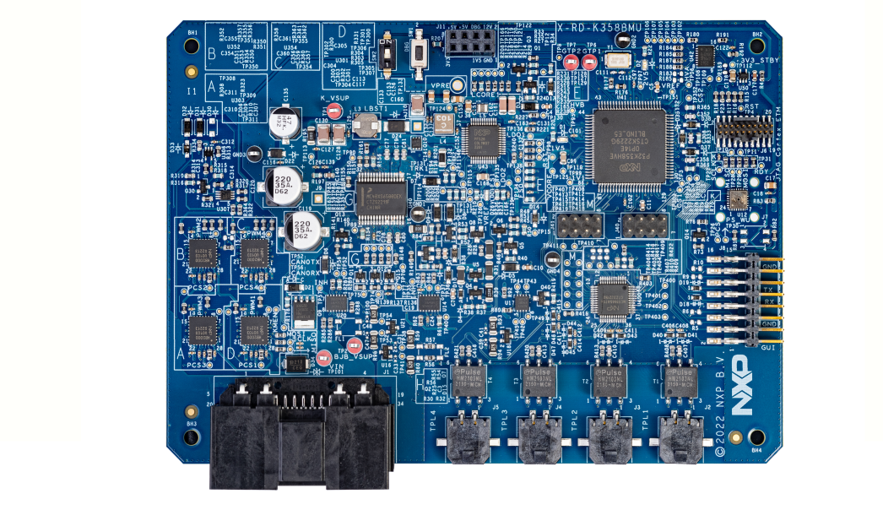
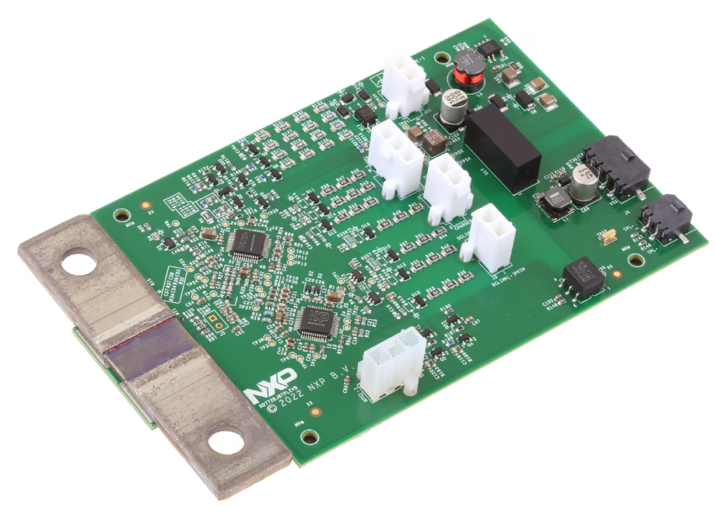
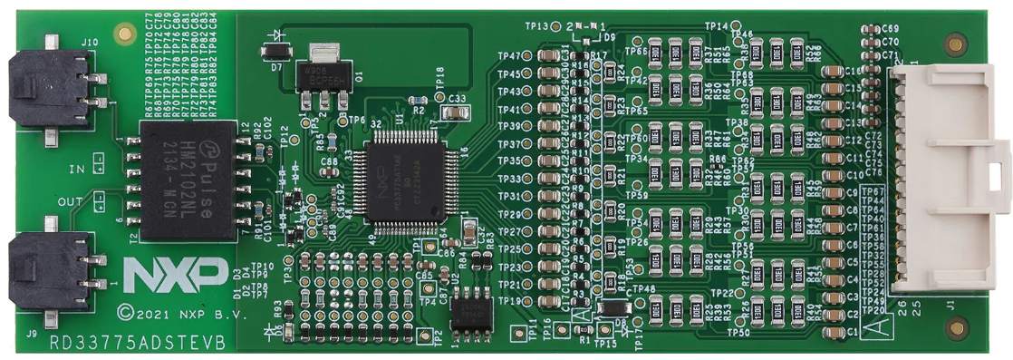
System-Level Demo of NXP HV BMS Reference Design
Overview: A complete and ready-to-use development and evaluation platform (reference design bundle)
Purpose: Designed to build and test 800 V high-voltage battery management systems, making it easier and faster to design custom BMS solutions.
Communication system: ETPL-based communication¹
Manufacturer: NXP Semiconductors
Contents: Includes both a hardware kit and several software packages
BMU
CMU
BJB
Reference Design Top View²
¹Electrical Transport Protocol Link (ETPL) is a two-wire, high-speed communication protocol used within NXP's battery management systems, enabling reliable and synchronized data transfer between key components, such as BMU, CMU and BJB.
²BMU (Battery Management Unit): Monitors battery cells and performs balancing, CMU (Cell Monitoring Unit): Collects BMU data and controls the system, BJB (Battery Junction Box): Contains contactors, fuses, and sensors.
Notes:
RD-HVBMSCT800BUN HVBMS Reference Design Bundle

Slide 3
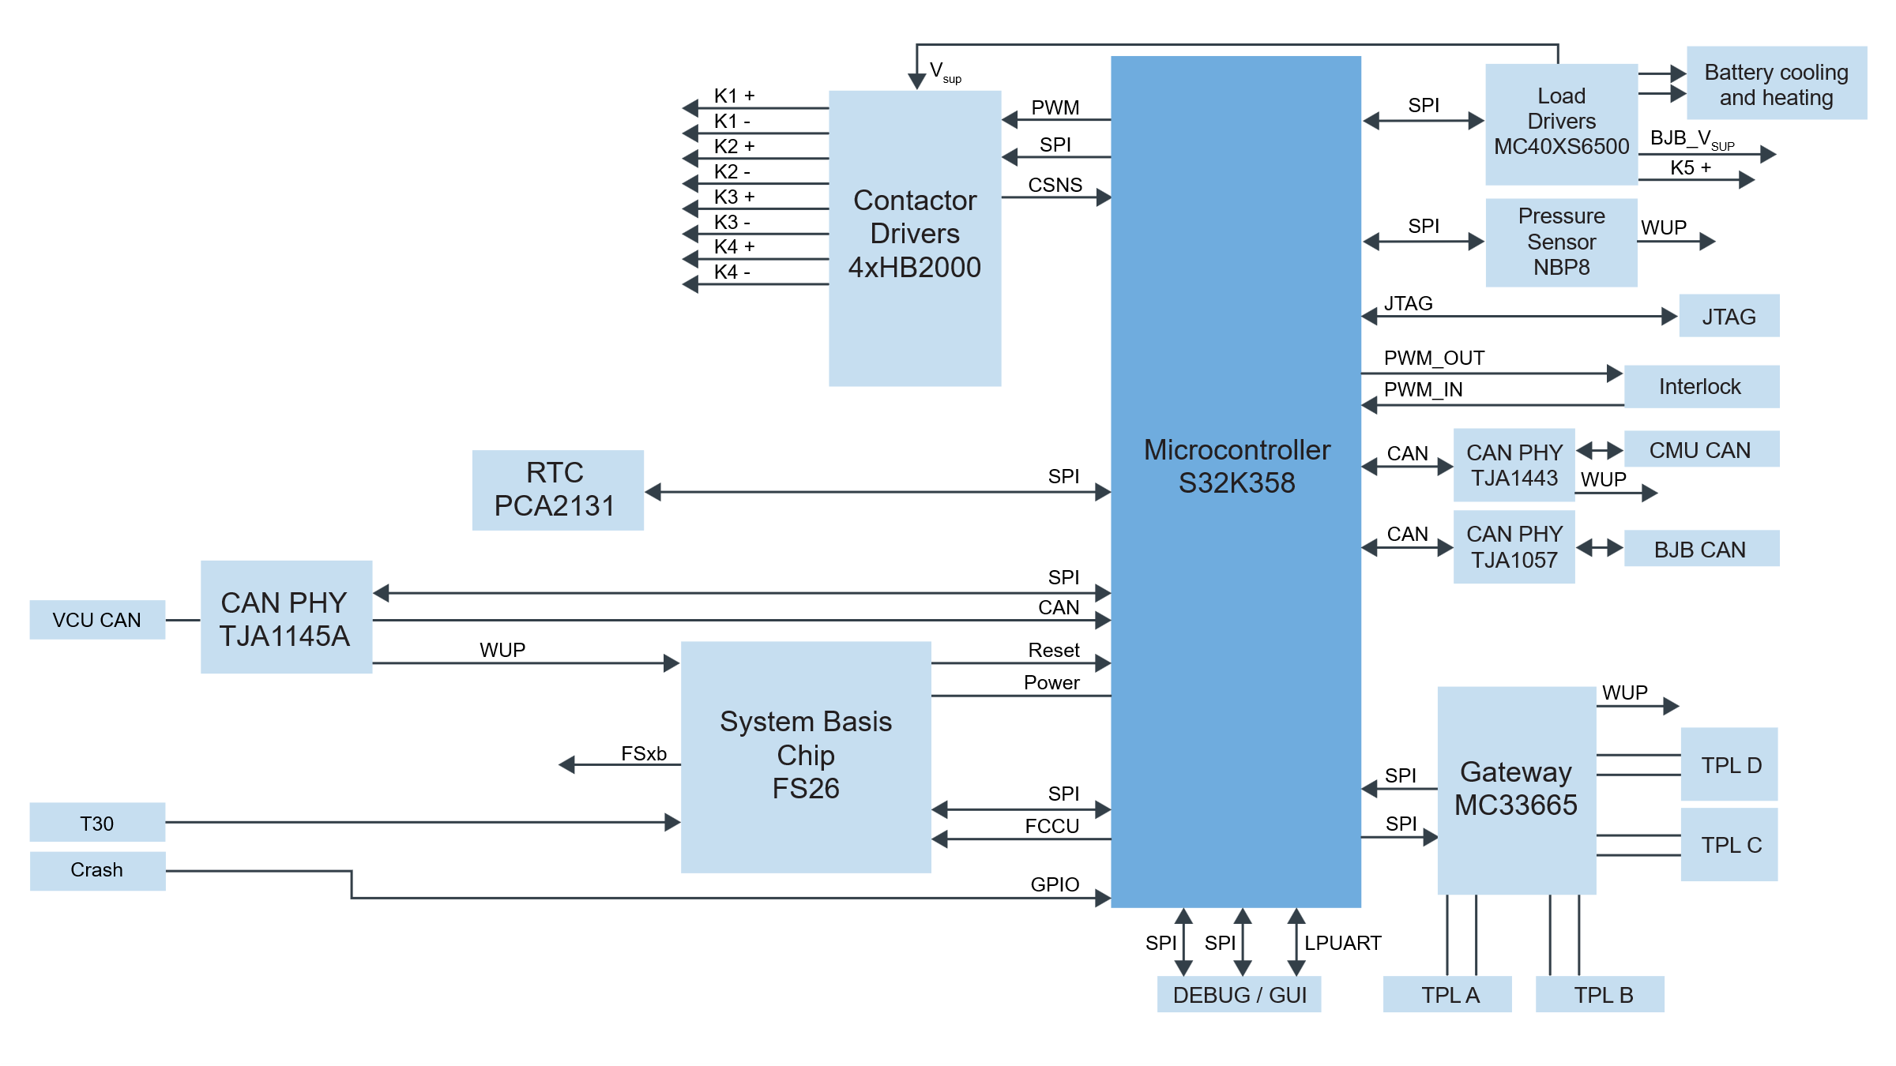
Kit content
Battery Management Unit (BMU)
– 1 RD-K358BMU board
– 1 power supply (12 VDC, 5 A)
– 1 multipurpose cable
– 1 USB-TTL cable
– 1 Electrical Transport Protocol Link (ETPL) cable
Purpose: Collect all data communicated to vehicle control unit (VCU) and make important safety decisions.
Key Feature: 3x CAN FD, 4x ETPL interfaces, protected contactor/valve control, synchronized SoH measurements, and thermal runaway detection via pressure sensor.
Block Diagram of RD-K358BMU
Buy Options: https://www.nxp.com/part/RD-K358BMU
Notes:
User Guide: https://www.nxp.com/docs/en/user-guide/RDK358BMUUG.pdf

Slide 4
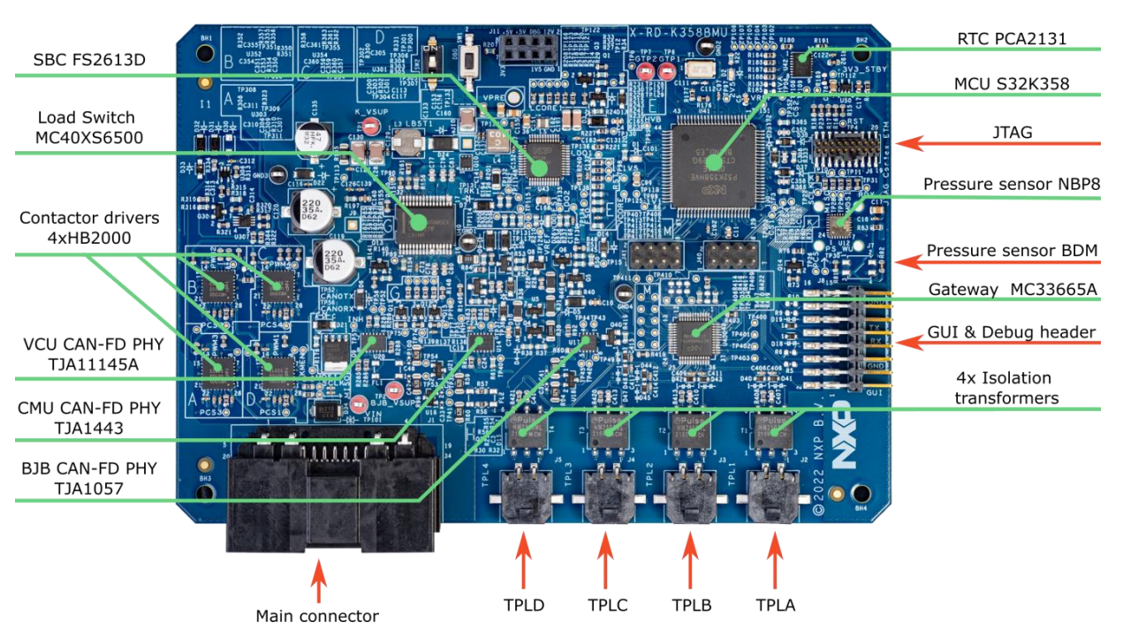
RD-K358BMU Interfaces and IC Location

Slide 5
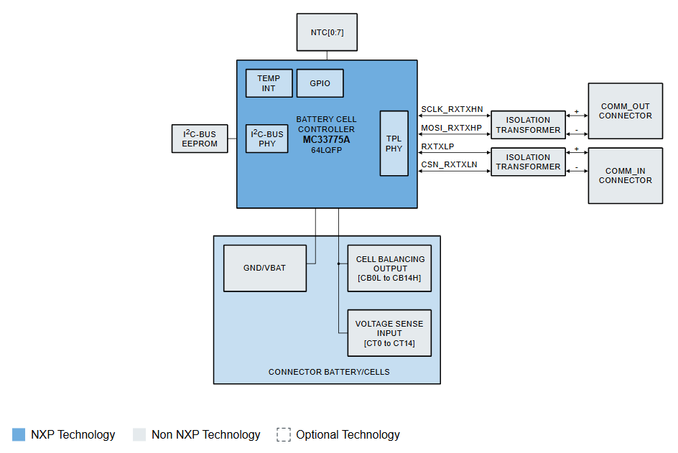
Kit content
Centralized Cell Monitoring Unit (CMU)
– 1 RD33775ADSTEVB board
– 1 supply cable
– 1 ETPL cable
Purpose: Cell voltage measurement, temperature measurement, bus bar monitoring and cell balancing of MC33775A-based applications¹
Key Feature: The board can be connected to NXP 14-cell battery emulator or a customer Li-ion battery module with 4-14 cells in series.
Block Diagram of RD33775ADSTEVB
¹The MC33775 is a 14 cell lithium-ion battery cell controller IC designed for automotive applications. It measures high-precision differential cell voltages and temperatures, supports ASIL D for voltage and temperature monitoring, performs passive cell balancing across battery stack, and communicates via SPI and isolated daisy chain interface. Due to the daisy chain configuration, more BCCs (or CMUs) can be added to extend the system. The system extends from a single MC33775A (monitoring up to 14 cells) to 15 MC33775As, allowing monitoring of up to 210 cells in total (15 × 14).
Buy options: https://www.nxp.com/part/RD33775ADSTEVB
Notes:
Board website: https://www.nxp.com/design/design-center/development-boards-and-designs/RD33775ADSTEVB
User Guide: https://www.nxp.com/document/guide/getting-started-with-the-rd33775adstevb-evaluation-board:GS-RD33775ADSTEVB
This board is part of the HWRD-HVBMSCC bundle using CAN-FD.
cell voltage measurement, temperature measurement, bus bar monitoring and cell balancing

Slide 6
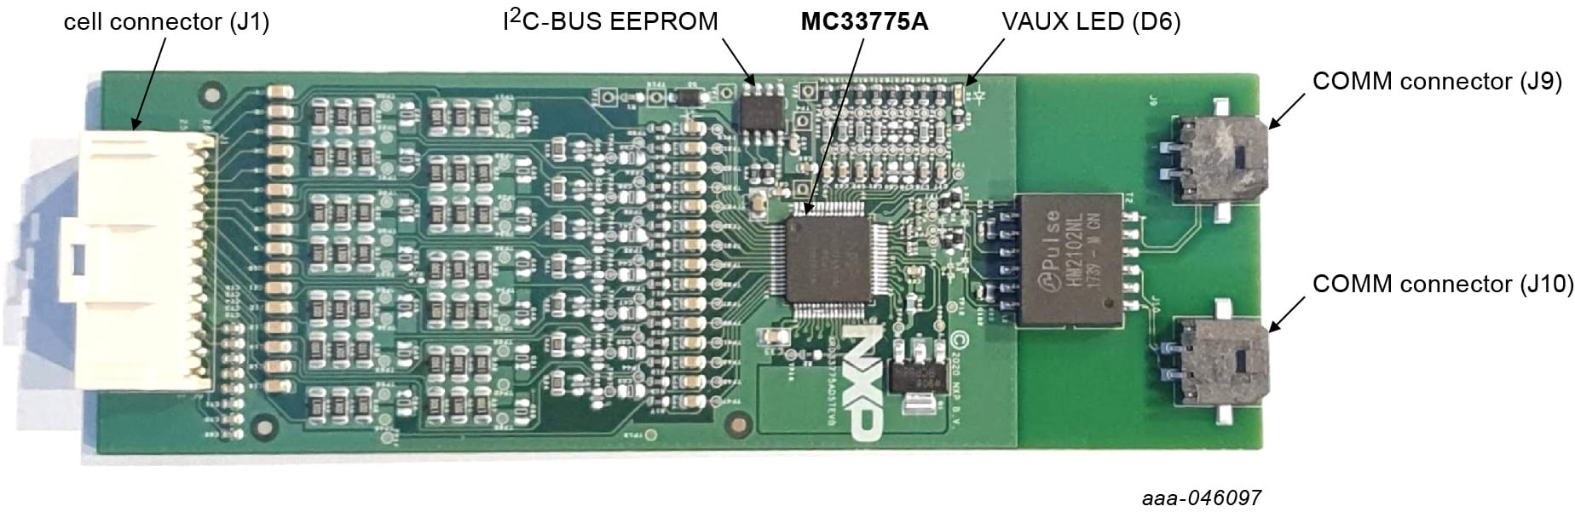
CMU Board (RD33775ADSTEVB) Components

Slide 7
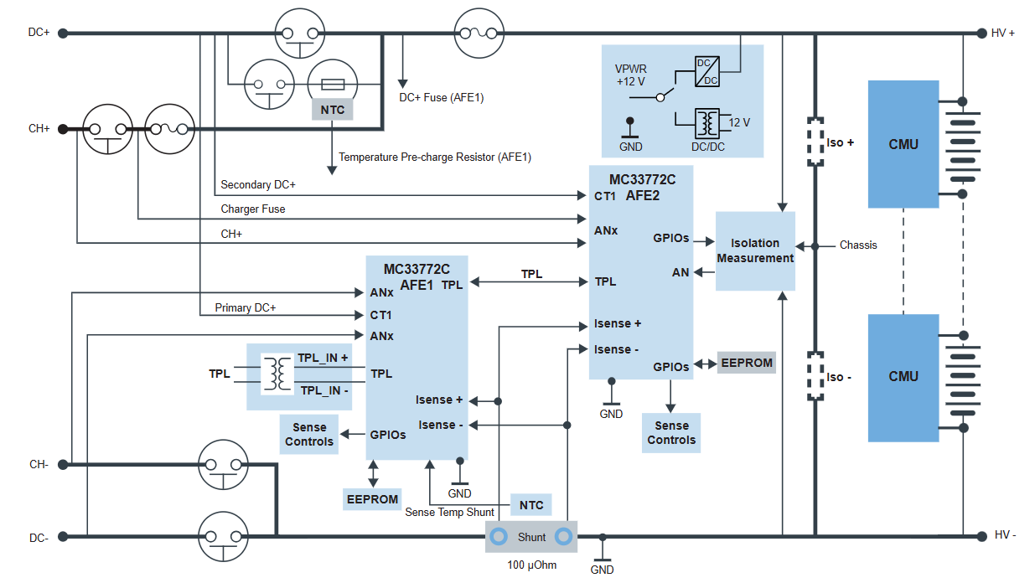
Kit content
Battery Junction Box (BJB)
– 1 RD772BJBTPLEVB board
– 1 power cable
– 3 high-voltage measurement cables
– 1 thermal sensor cable
– 1 ETPL cable
Purpose: Current measurement, high voltage measurements and isolation monitoring.
Key Feature: The board contains two MC33772C¹ battery sensors for redundant high voltage and current measurements.
Block Diagram of RD772BJBTPLEVB
¹The MC33772C is a Li-Ion battery cell controller (BCC) IC with 6 Cell Voltage Measurement Channels offering high-precision battery monitoring with integrated ADCs for voltage, current, and temperature measurements, plus embedded balancing and scalable daisy chain communication for up to 63 nodes.
Buy Options: https://www.nxp.com/part/RD772BJBTPLEVB
Notes:
Board Website: https://www.nxp.com/part/RD772BJBCANFDEVB User Manual: https://www.nxp.com/docs/en/user-manual/UM11846.pdf

Slide 8
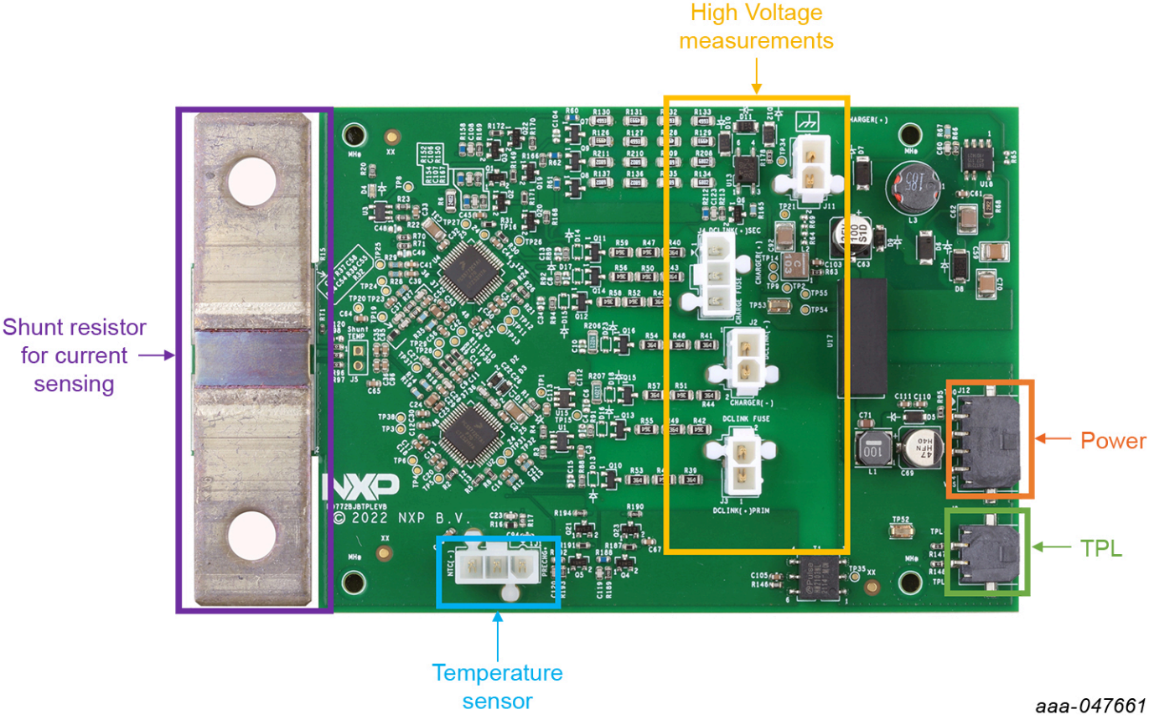
Region of functions over the BJB (RD772BJBTPLEVB) Board

Slide 9
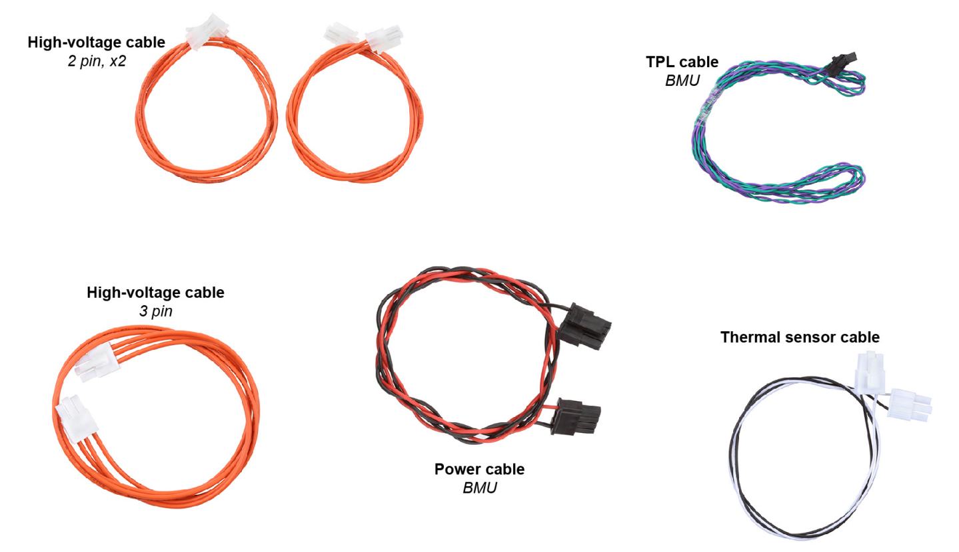
RD772BJBTPLEVB Cables

Slide 10
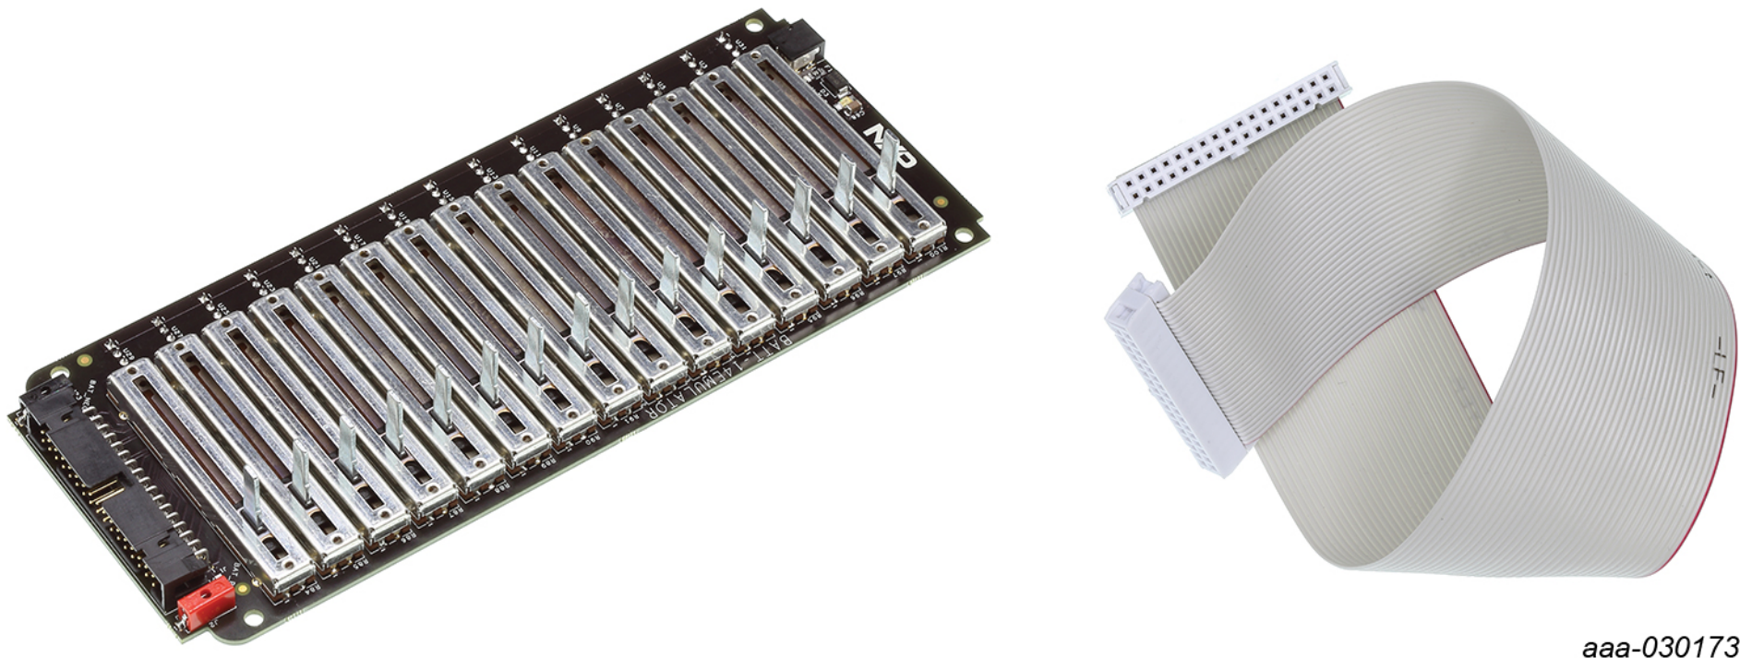
Kit content
Battery emulation kit
– 1 BATT-14EMULATOR board
– 1 ribbon cable that allows the user to connect the slider battery pack emulator to the MC3377x evaluation kits.
Purpose: Emulate multi-cell battery packs, for quick evaluation and software development for NXP’s MC33771 and MC33772 battery cell controllers.
Key Feature: Adjustable cell voltage (1.26–4.8 V), 14-cell emulation up to 3 in series, LED power indicator.
BATT-14EMULATOR kit components
Buy options: https://www.nxp.com/part/BATT-14EMULATOR
Notes:
Download the Pack Emulator user manual: https://www.nxp.com/webapp/sps/download/preDownload.jsp?render=true ​

Slide 11
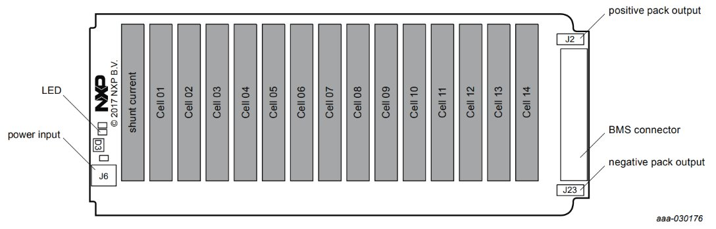
BATT-14EMULATOR Board Components

Slide 12
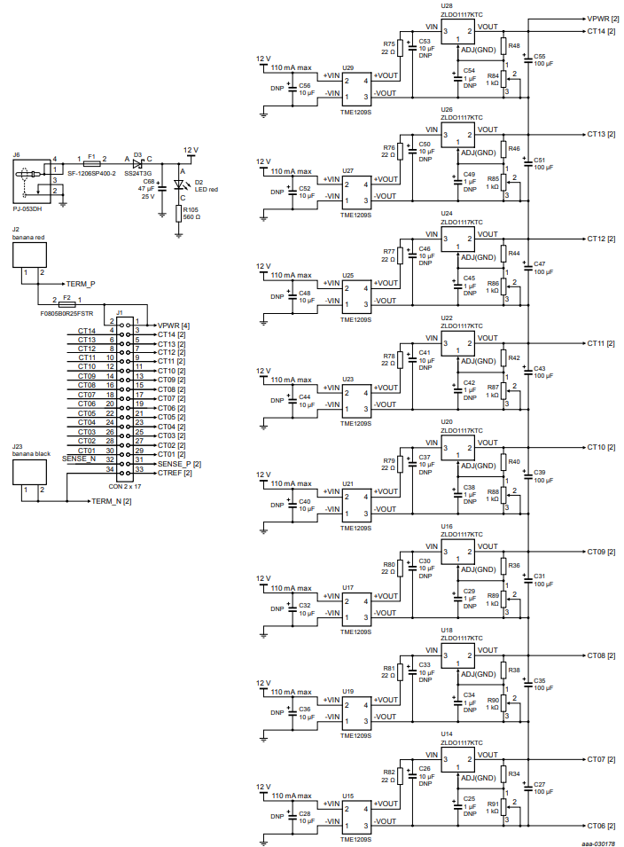
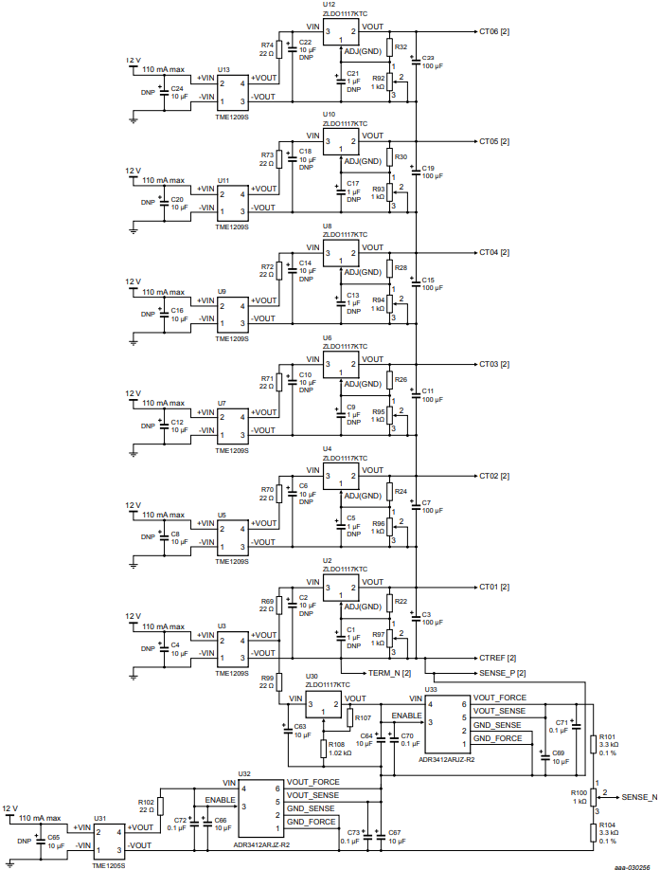
BATT-14EMULATOR Schematic
(1)
(2)
For a clear image, please download the BATT-14EMULATOR User Manual from https://www.nxp.com/webapp/Download?colCode=UM11124

Slide 13

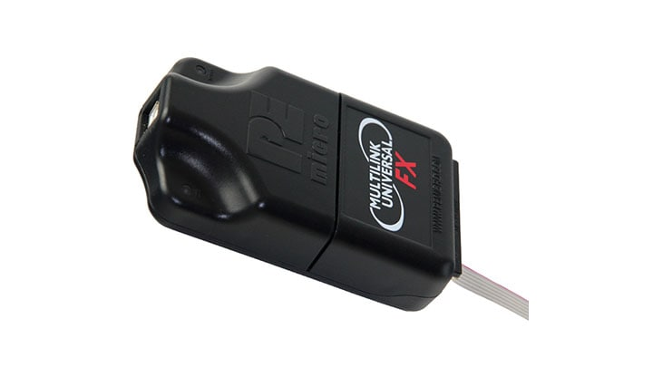
Hardware Requirements
The kit contents as mentioned in the previous slides.
A PC, to run the provided GUI and program the RD-K358BMU board.
A JTAG debugger to program the RD-K358BMU board. The recommended debugger is a PEmicro Multilink FX.
PEmicro Multilink FX
PC

Slide 14
Software Requirements
In addition to the kit contents, the following software is beneficial when working with this kit.
MATLAB and Simulink and other relevant MathWorks libraries (Add-ons)
Supported and Compatible C/C++ Compiler
NXP_Support_Package_S32K3xx
NXP_Support_Package_BMS
Debugger Driver Multilink USB Universal LC
NXP GUI 10.0.0
FreeMASTER 3.2 (for measurement visualization using the HVBMS Start-up interface)¹
Git (for version control)
¹FreeMASTER is a user-friendly real-time debug monitor and data visualization tool that enables runtime configuration and tuning of embedded software applications, with integrated drivers for S32 Design Studio.

Slide 15
Thank you
McMaster Automotive Resource Centre (MARC)
15

